Slide 1
Netflix Data Analysis and Movie Recommendation
Data Science & Machine Learning Project
By - Shruti Gupta

Slide 2
Introduction
Netflix dataset contains an extensive catalog of movies and TV shows and relevant information about them

Slide 3
Objective
To analyze the dataset based on ratings, directors, categories and other features.
To visualize the same with graphs
To Recommend 5 similar movies based on genre using ML algorithms

Slide 4
Tools & Frameworks Used
Python for EDA
Matplotlib and Seaborn libraries for visualization
Sci-kit learn for ML preprocessing
TfidfVectorizer and cosine similarity for machine learning recommendation

Slide 5
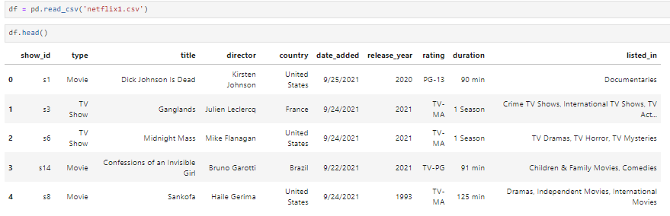
Dataset – netflix1.csv
First 5 rows of the dataset

Slide 6
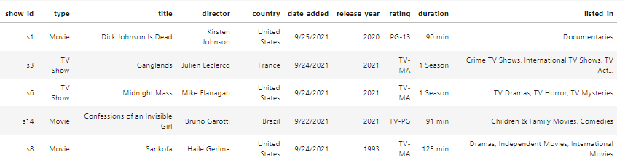
The analysis will be done based on the following features
Type
Country
Release year
Rating
Recommendation will be done based on
Listed_in

Slide 7


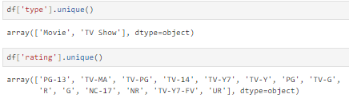
EDA – Data Cleaning & Preprocessing
Find the size of the dataset
Drop duplicate entries
Find Unique values for categorical features – ‘Type’ and ‘Rating’

Slide 8
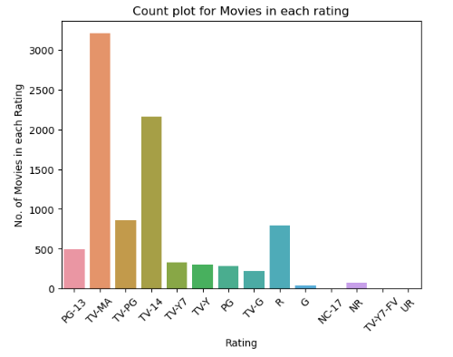

Data Visualization
Rating vs No. of movies
INFERENCE
Maximum movies have been rated ‘TV-MA’ and ‘TV-14’

Slide 9
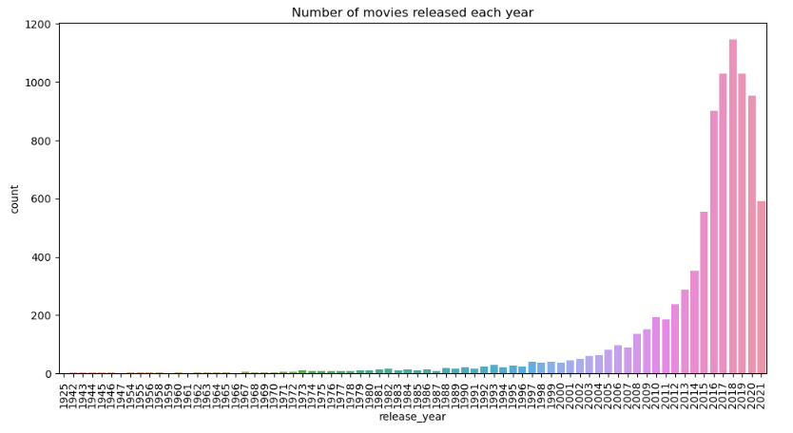

Data Visualization
INFERENCE
Maximum movies/tv shows were released in 2018
Also we can see a steady increased in the number of releases since 1979 to 2018, after 2018 the number started descending
No. of movies released each year

Slide 10
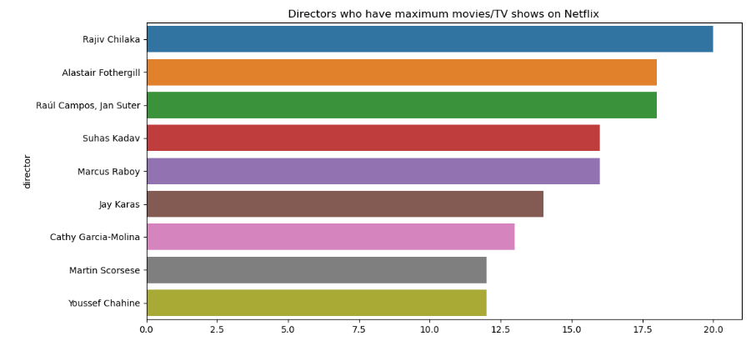
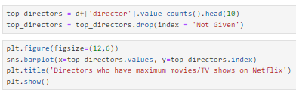
Data Visualization
INFERENCE
Maximum movies/tv shows were directed by ‘Rajiv Chilaka’
Top 10 Directors with maximum movies/TV shows

Slide 11
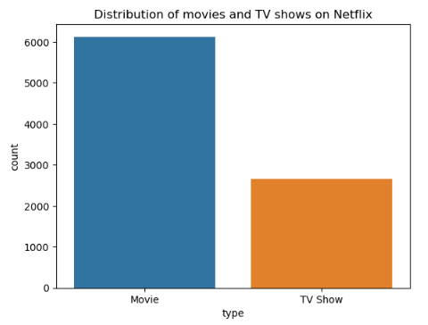

Data Visualization
Movies vs TV/Shows
INFERENCE
There are more than double movies than TV shows on Netflix

Slide 12
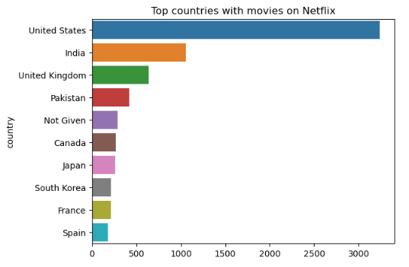

Data Visualization
Top 10 Countries with maximum content on Netflix
INFERENCE
USA and India have produced the maximum content on Netflix

Slide 13
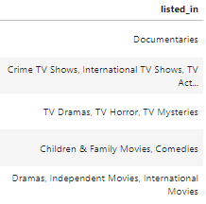
Recommendation System - Machine Learning
We will use ‘listed_in’ feature to find movies that have similar genres.
First we will create a sparse matrix of the listed_in feature using TfidfVectorizer
Then get the vector of a particular movie that needs recommendation.
Use cosine_similarity to find similar vectors

Slide 14

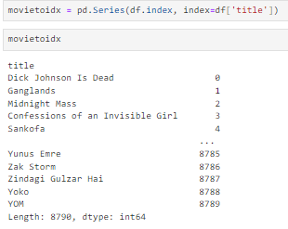
Recommendation System - Machine Learning
Convert words into vectors using TfidfVectorizer
Create a Series of movie titles and indexes for better retrieval

Slide 15
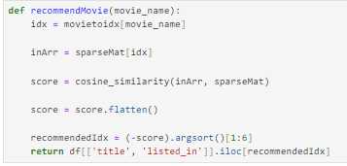
Recommendation System - Machine Learning
3. Function recommendMovie() takes the name of movie and returns a list of similar indexes using cosine_similarity model. The scores are sorted in decreasing order and top 6 values are returned, except the first, as the first one will be the input movie itself

Slide 16
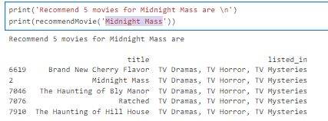
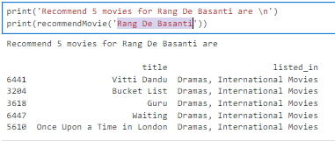
Recommendation System - Machine Learning
Let’s find recommendations for the movie
‘Midnight Mass’
‘Rang De Basanti’

Slide 17
Thank You!
Shruti Gupta

